Slide 1


Relationship between water quality and money in the US: A data analytical approach
TEAM 30

Slide 2
Content
Context and approach
1
Modeling and tools used
2
Conclusions
3
Project definition
Data sets
Exploratory Data Analysis - EDA
Data Cleaning
Predictive Analysis
Result of the excersice

Slide 3
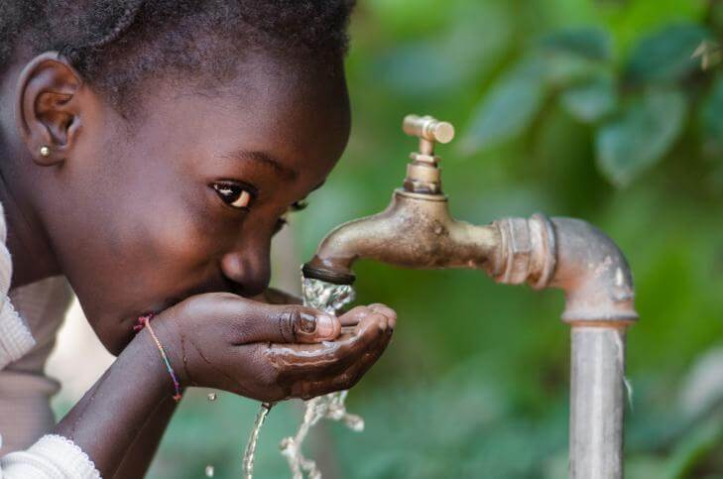
Context
Human life is impossible without water, covering roughly 70% of the Earth’s surface and accounting for 60% of an adult’s body by weight.
Clean drinking water is necessary for survival, but access to fresh water is also essential for irrigation of crops, industrial activities, basic hygiene, medical care, etc.
Esta foto de Autor desconocido está bajo licencia CC BY-NC-ND

Slide 4
Question
“Is there a relationship between profitability/income and water quality in United States Counties?”

Slide 5
1. Datasets
Earnings
Chemical
Water usage
Industry
County votes
Population

Slide 6
Chemicals!
Uranium
Arsenic
DEHP
Trihalomethane
Nitrates
Haloacetic Acids

Slide 7
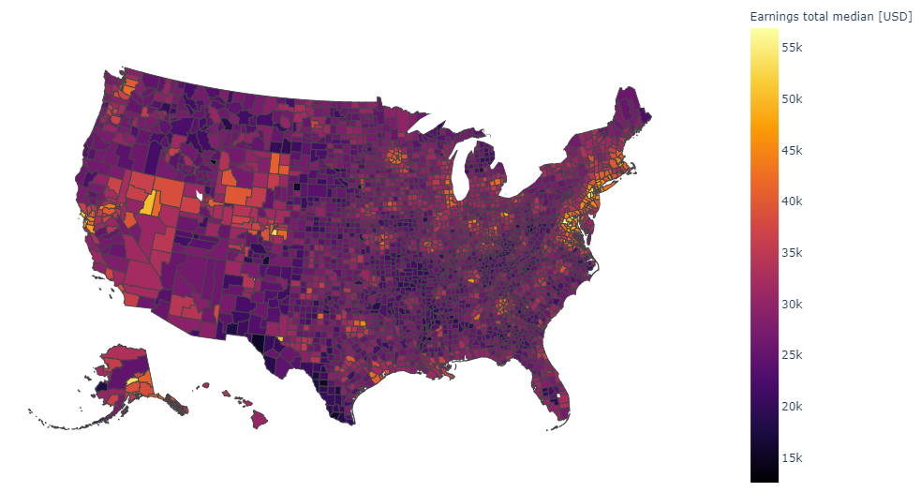
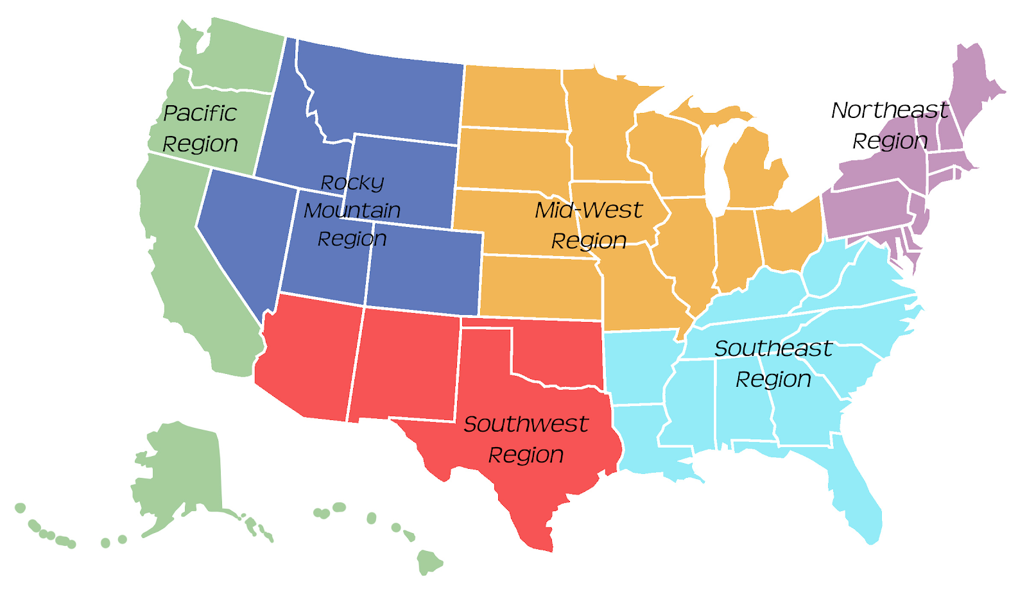
Political, economical and demographic variables
Total median of earnings
Regions of the USA
MCL
Maximum Contaminant Levels

Slide 8
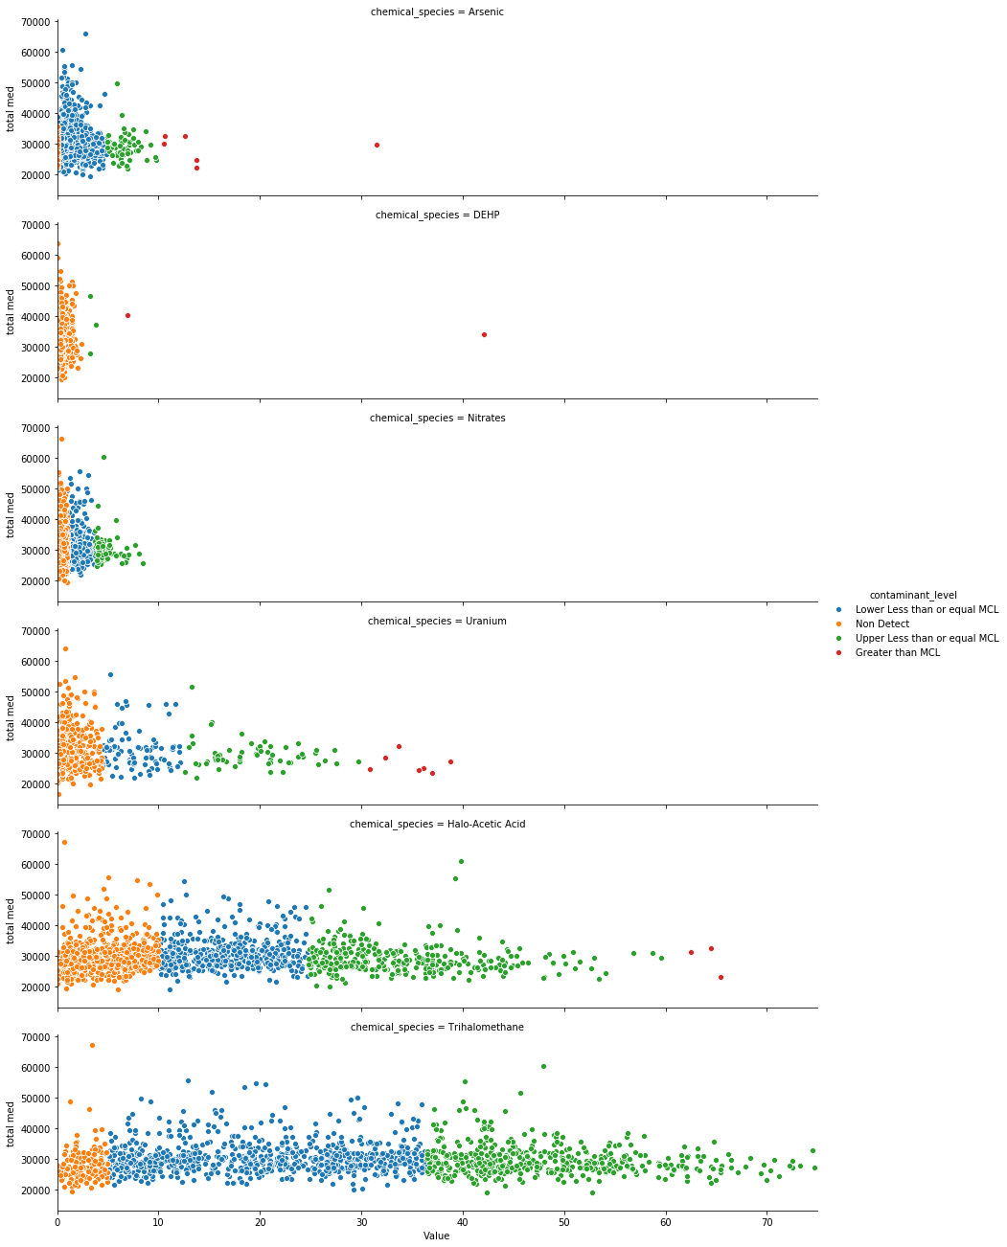
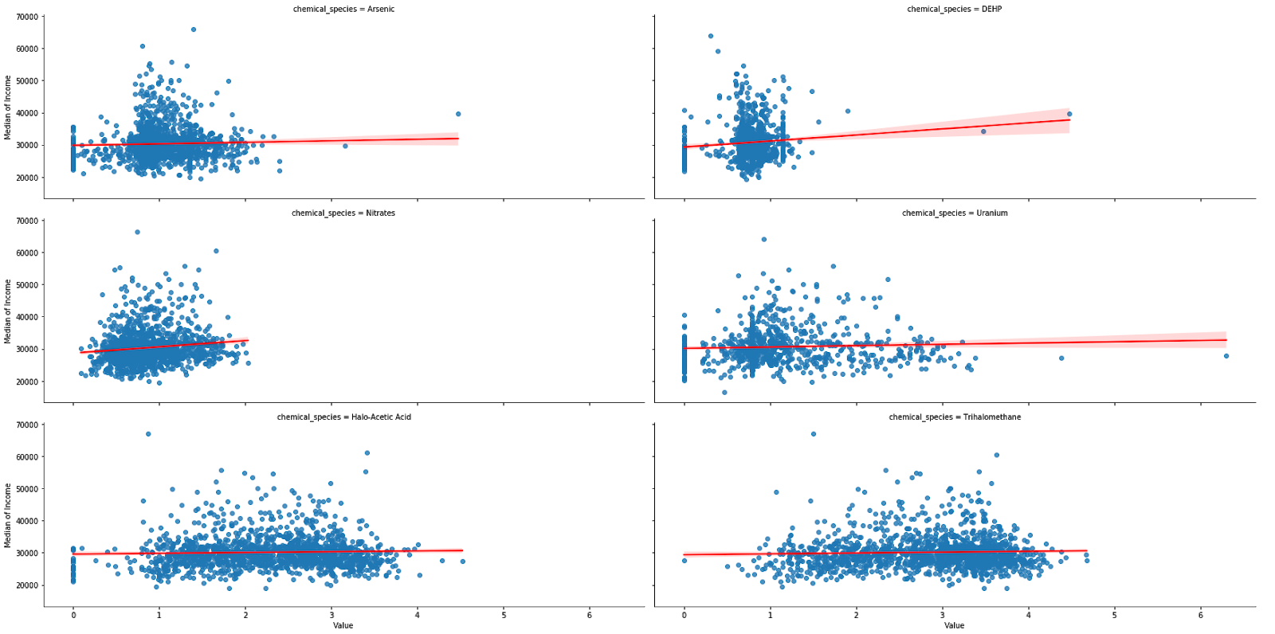
Income vs Contamination

Slide 9
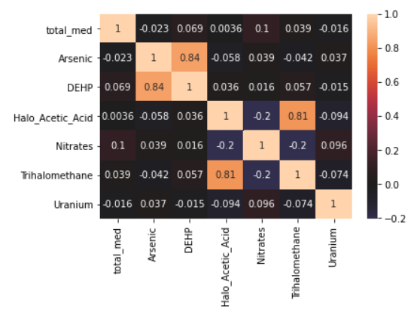
Correlation matrix chemicals

Slide 10
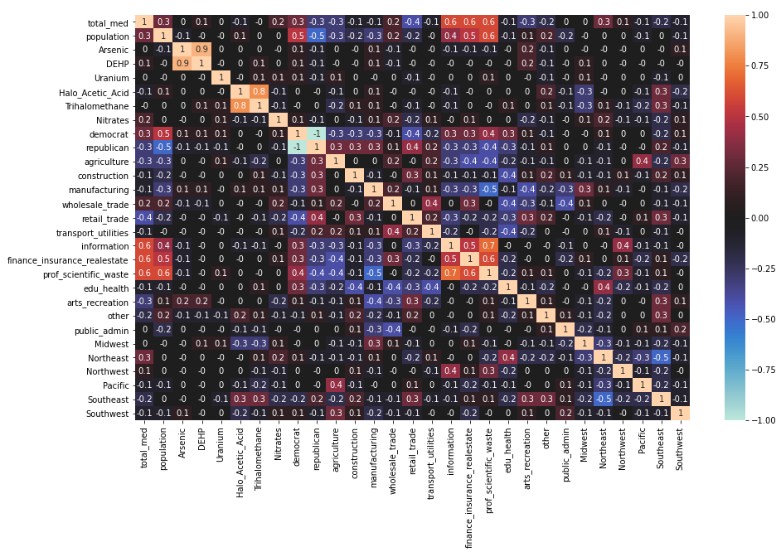
Correlation matrix all variables

Slide 11
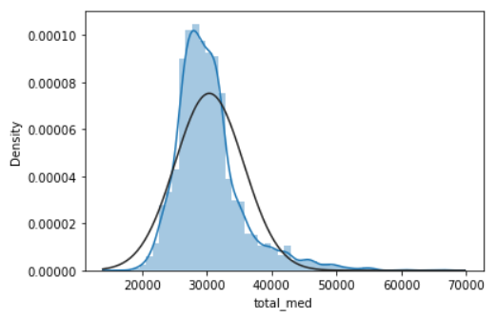
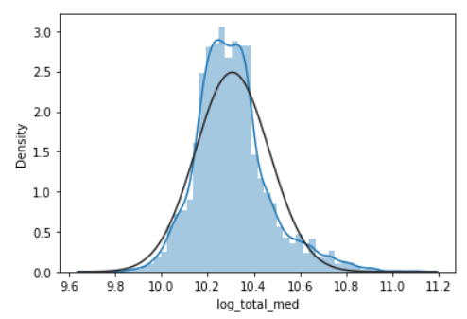
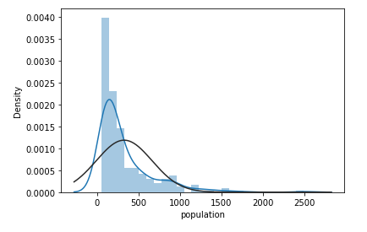
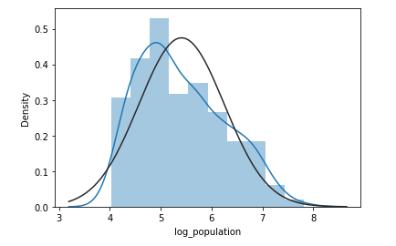
Box-Cox Transformations
Logarithmic
Logarithmic

Slide 12
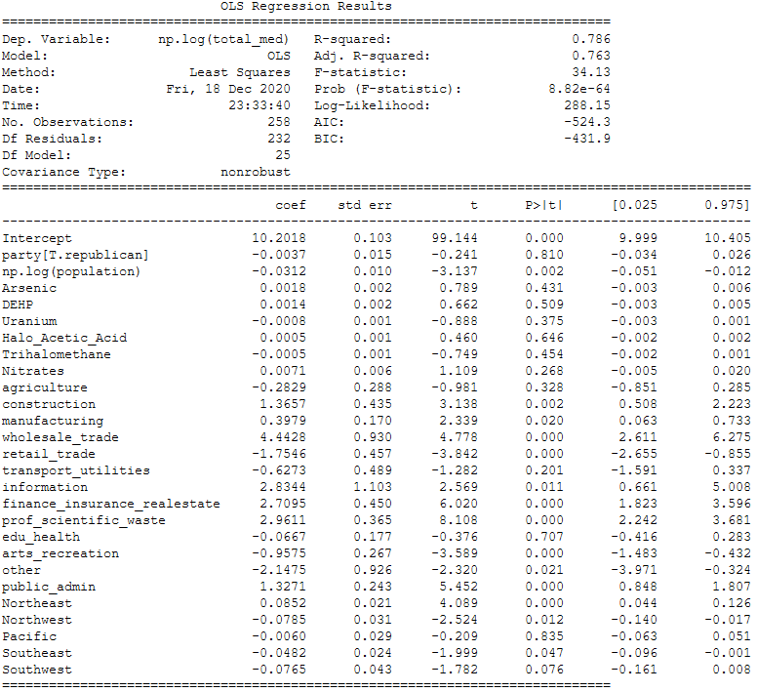
Time for Linear Regressions
R - squared
0,78

Slide 13
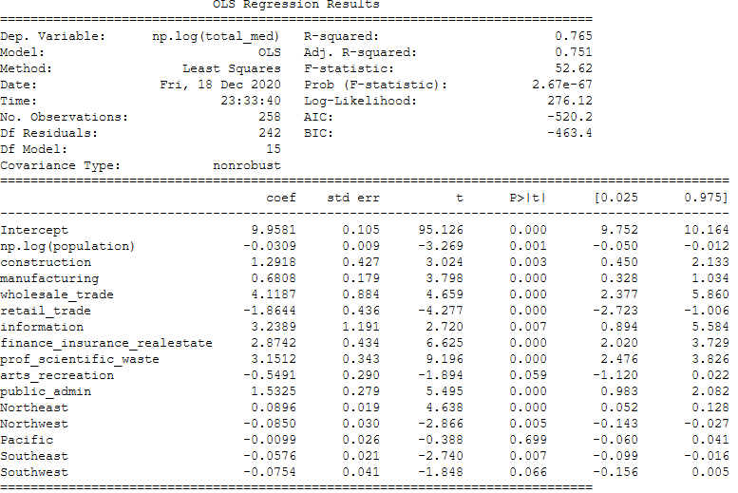
Reducing the Linear Regression
R SQUARED
0,765
Images reveal large amounts of data quickly, so remember: use an image instead of long texts. Your audience will appreciate that.
Venus has a beautiful name and is the second planet from the Sun. It’s terribly hot—even hotter than Mercury—and its atmosphere is extremely poisonous

Slide 14

So, the conclusion!
Is that the contamination of these chemicals in water systems in Counties in the United States have no linear relation with the median on income, but the traditional approach seems to explain it better.
Also, it could be of interest to expand the span of places that could be polluted (including air, for example) and increase the span of chemicals.

Slide 15
Industrial Engineer
Mathematician
Systems engineer
Julián Gómez
Esperanza Palacios
Leonardo Briceño
Mechanical Engineer
Economist
Joham Álvarez
TEAM 30
Cristhian Córdoba

